Slide 1
Cloud-Assisted Precision Agriculture: A Framework for Automated Irrigation and Plant Health Monitoring - Internet of Things, Machine Learning, Formal Verification, Cloud
Presented By:
Sri Vasavi Peravarapu
Sumanth Kumar Sivadi
Hema Likitha Adapa
Varsha Pravallika Valavala
Kaushik Ram Koteshwar Venna

Slide 2
Introduction
Agriculture is a cornerstone of the global economy, forming the backbone of food security and supporting the livelihoods of billions worldwide.
Despite its critical role, the sector is under increasing pressure due to the dual impact of a growing global population and escalating environmental challenges.
Rapid urbanization and industrialization have led to the depletion of natural resources, while unpredictable climate patterns exacerbate the difficulties faced by farmers.
In developing regions, these challenges are particularly acute, as farmers often lack access to efficient irrigation systems, timely disease detection methods, and advanced agricultural technologies.
These persistent issues not only hinder productivity but also amplify financial burdens, leaving farmers vulnerable to economic instability and food supply chains at risk.

Slide 3
Motivation
With the world’s population projected to exceed 9 billion by 2050, the demand for food will require innovative solutions to improve agricultural efficiency.
The need to adopt technology-driven solutions to address inefficiencies in irrigation and crop health management.
Farmers need reliable tools that simplify decision-making, conserve critical resources like water, and protect crops from diseases.
Ensuring sustainable farming practices to meet future food security demands and long-term agricultural productivity.
Empowering farmers with user-friendly, cost-effective technology to make informed decisions and enhance productivity sustainably.

Slide 4
Problem Identification
Irrigation Challenges:
Over-irrigation leads to water wastage, while under-irrigation results in plant stress and reduced yields.
Manual irrigation practices are time-consuming and inefficient.
Plant Disease Challenges:
Early detection of diseases is critical but often missed due to lack of knowledge or timely intervention.
Crop losses due to undetected or misdiagnosed diseases can be devastating to farmers.
Technology Gap:
Existing systems are often fragmented, focusing on either irrigation management or disease detection but not both.
Limited accessibility and high costs deter small-scale farmers from adopting advanced solutions.

Slide 5
Problem Definition
The primary aim is to enhance agricultural productivity by reducing manual intervention, providing precise irrigation control, and enabling early detection and management of plant diseases
To address these challenges, we have developed a comprehensive system that integrates cutting-edge technologies, including:
IoT Sensors for real-time data collection on critical parameters such as soil moisture, temperature, and humidity.
Cloud Computing to store and analyze data, providing actionable insights through visualization.
Formal Verification (LTL) for automation, ensuring reliable and efficient irrigation control.
Machine Learning for accurate plant disease detection based on image analysis, enabling early intervention.

Slide 6
Overview
Domains: Cloud computing, IoT, Formal Verification (LTL), and Machine Learning.
Data Collection: Sensors gather temperature, humidity, and soil moisture data.
Visualization & Analysis: Data is sent to the ThingSpeak cloud platform for visualization and analysis.
Alerts & Automation: A formal verification LTL model monitors the data, and if values drop below a cutoff, it automatically triggers irrigation.
Plant Disease Detection: Images of plants are uploaded to detect diseases using machine learning techniques.

Slide 7
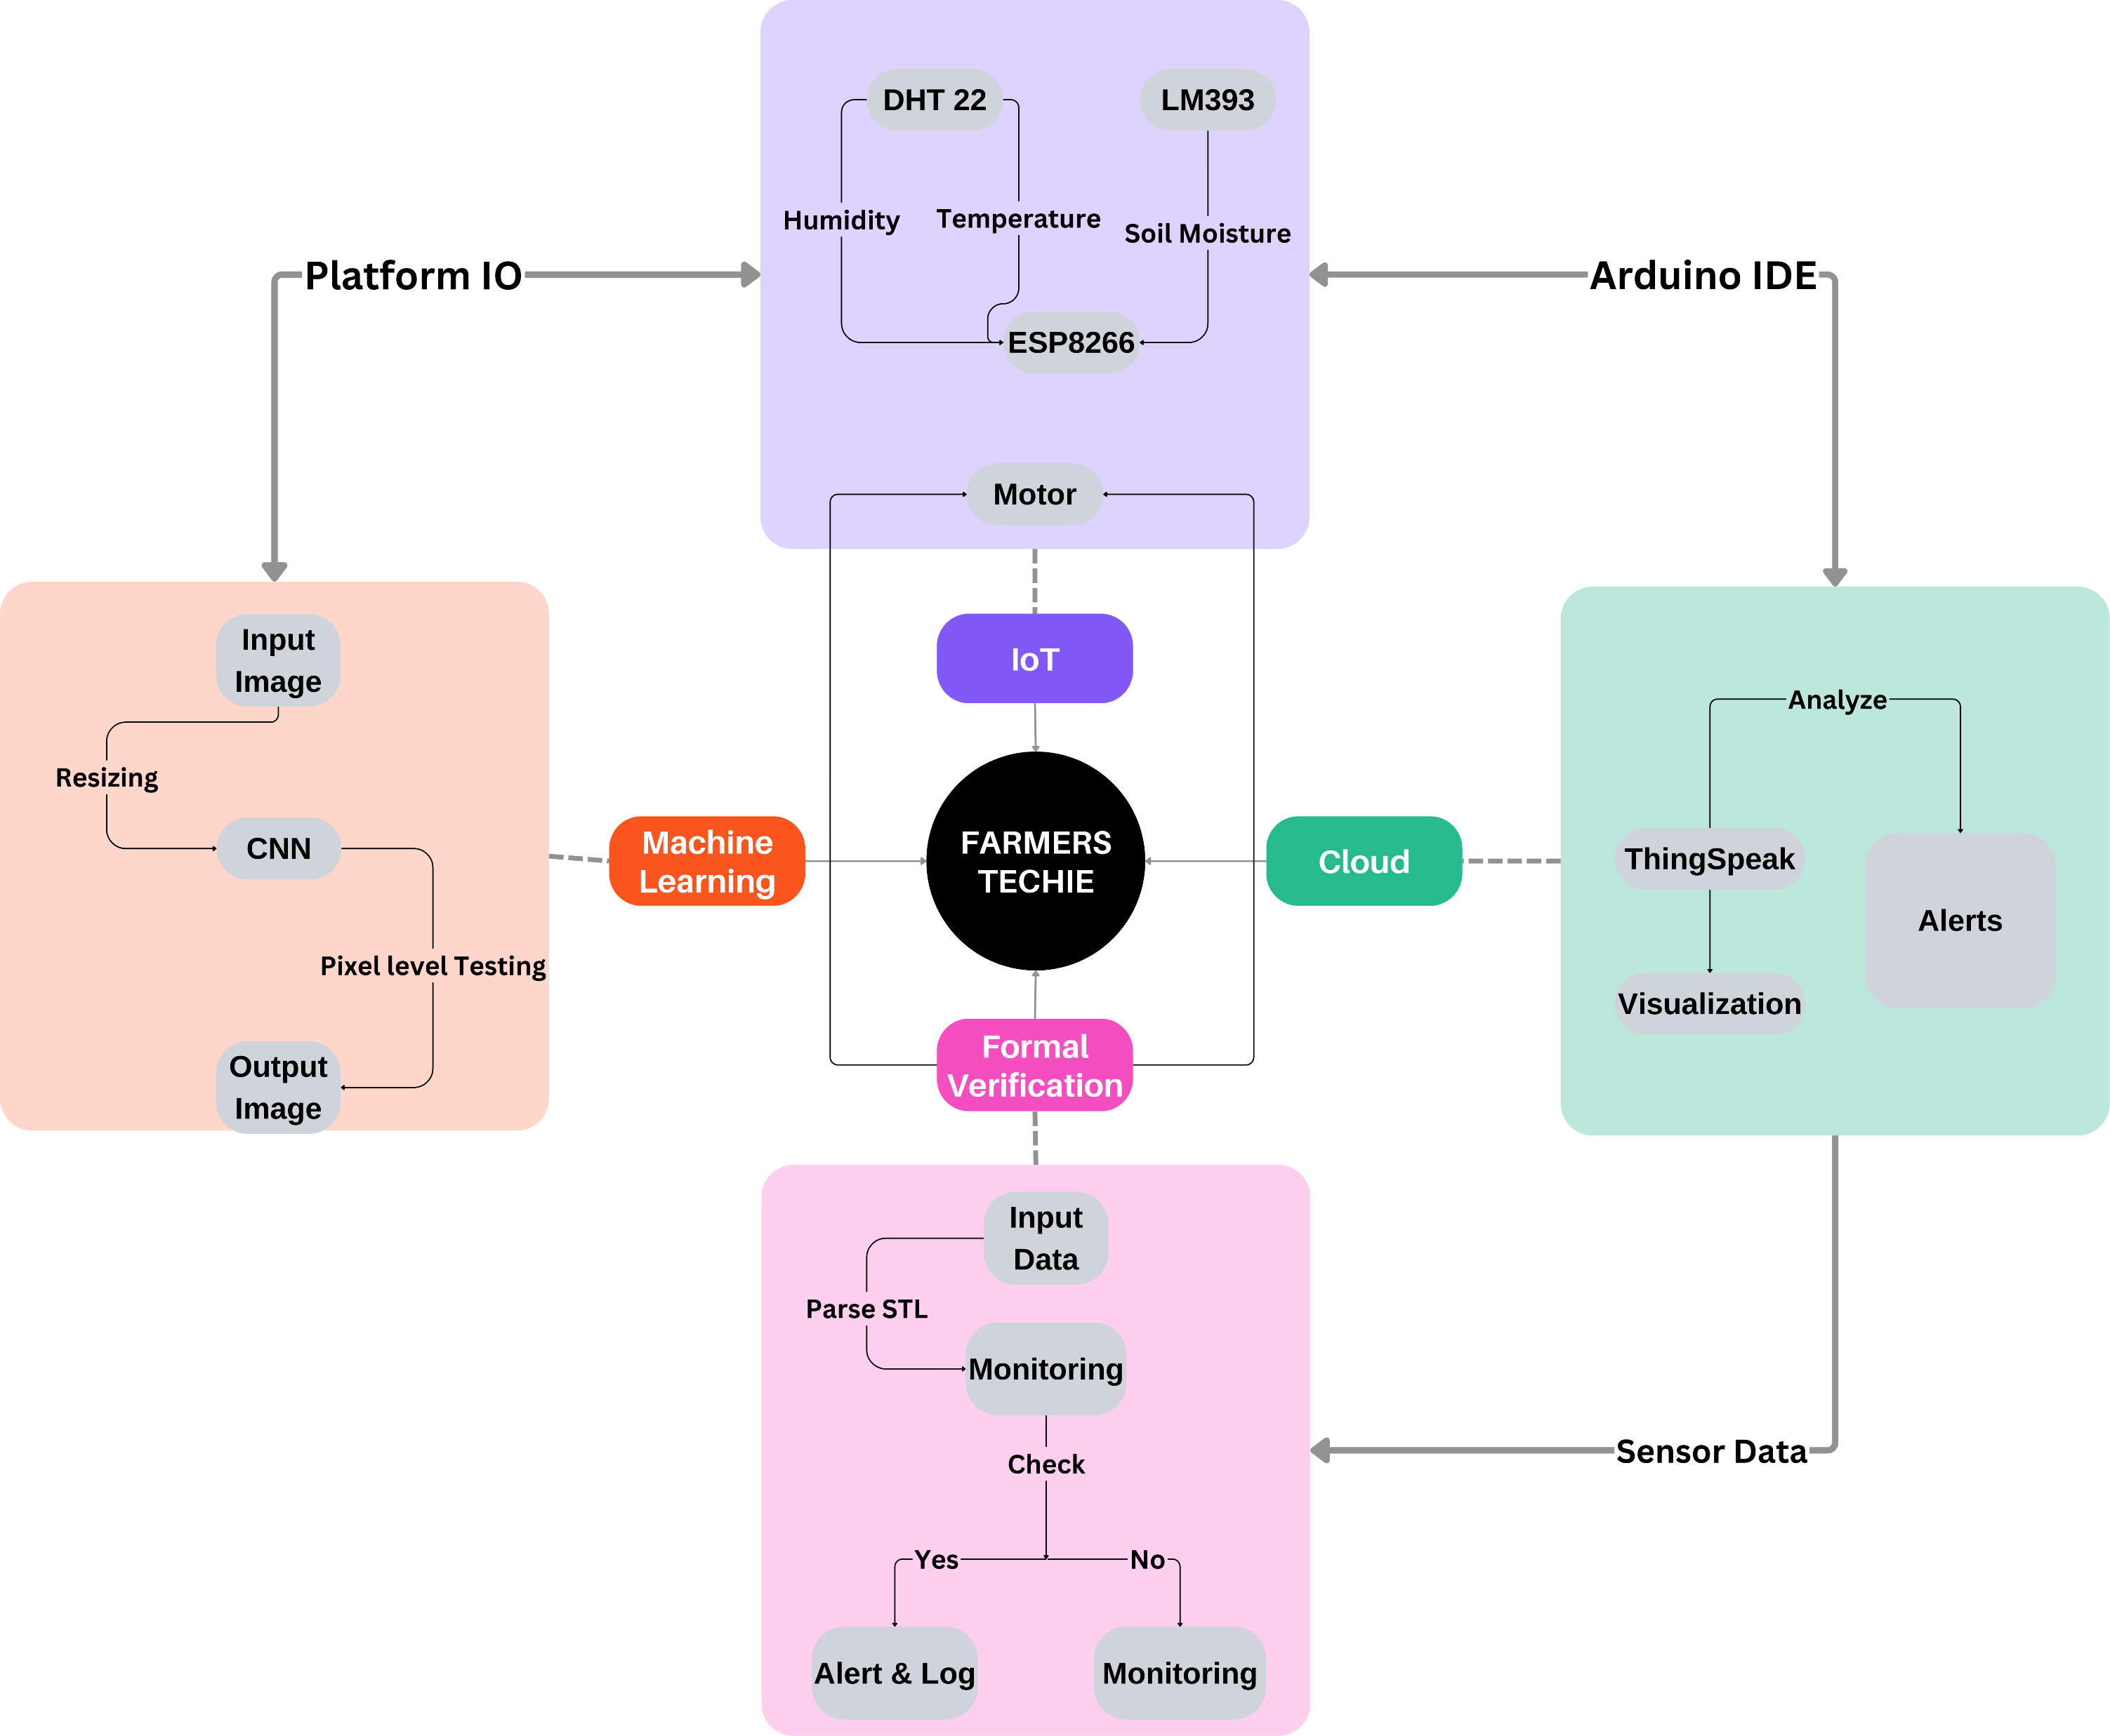
Flow Chart

Slide 8
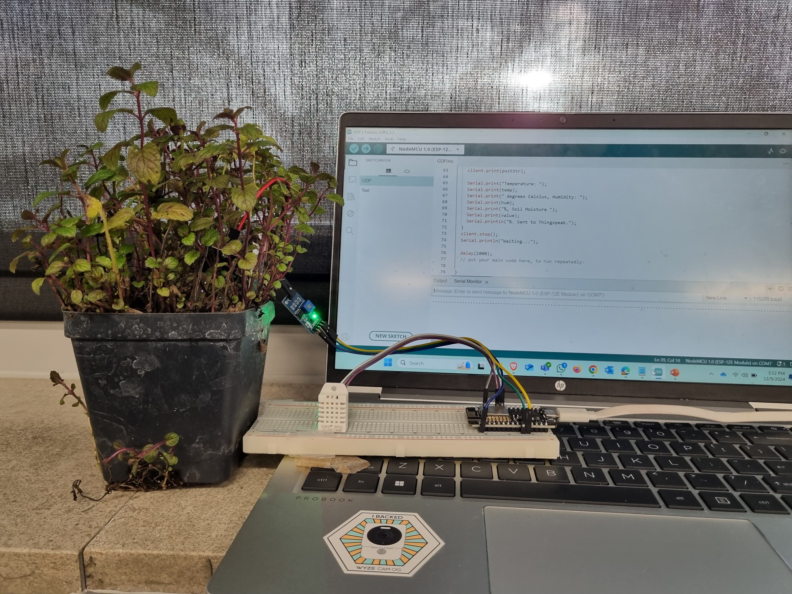
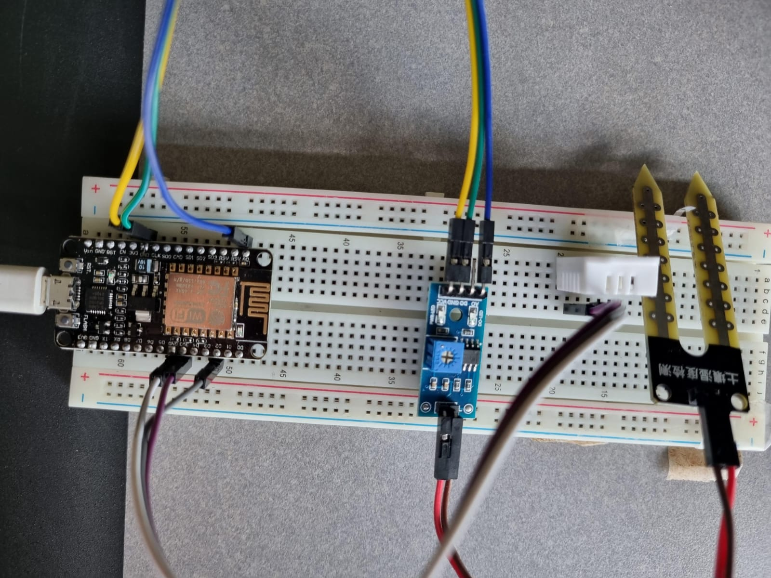
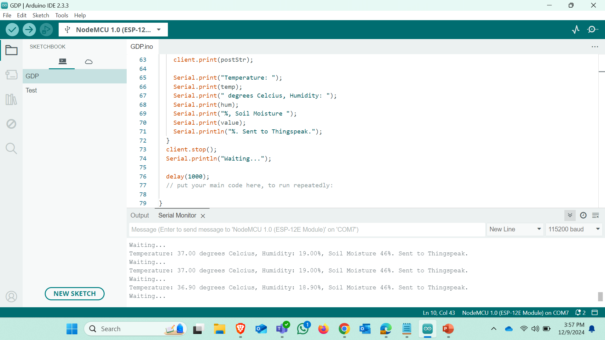
Connections

Slide 9
Updates
UI in Machine Learning
We redesigned the user interface to make the process of uploading crop images for disease detection simpler and more efficient.
This allows users to easily identify plant diseases through machine learning.
Formal Verification
We are implementing code with it to ensure system accuracy and logical consistency.
This will guarantee reliable automated decision-making.
Enhancements in IoT
We are improving the IoT system to store sensor data locally and ensure water motor activation based on real-time sensor values.
This enhances automation, resource efficiency, and data management.

Slide 10
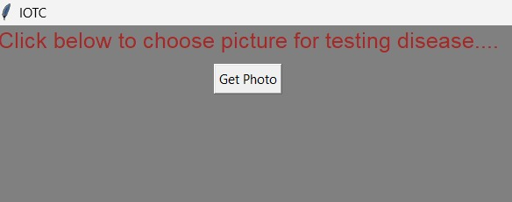
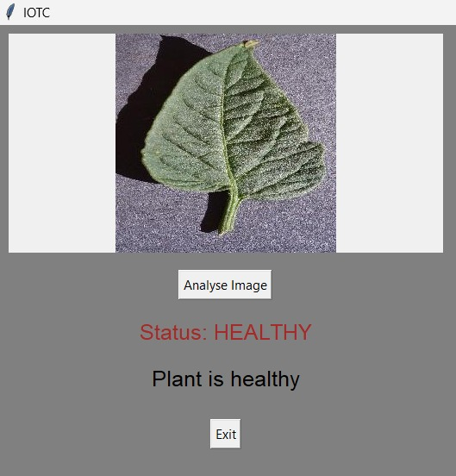
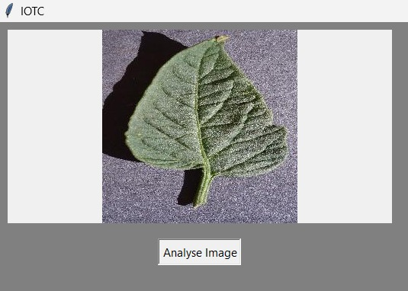
Demonstration

Slide 11
Future Works
Direct Camera Integration for Real-Time Analysis
Cameras will be integrated to capture crop images and upload them to the microcontroller, enabling faster and real-time disease detection.
Strengthen the IoT & Machine Learning Connection
IoT sensor data will be better integrated with machine learning models to provide real-time insights and predictive disease analysis for smarter decision-making.
Leverage Open-Weather Data for Strategic Decision-Making
Integrating weather forecast data from Open-Weather will optimize irrigation and pesticide application, conserve resources, and reduce environmental impact.
Enhancing Robotics for Disease Monitoring & Pesticide Application
Robotics will be used to monitor crops and apply targeted pesticide treatments, reducing chemical use by focusing only on diseased areas.

Slide 12
Conclusion
This project demonstrates the power of integrating IoT, Cloud Computing, Formal Verification, and Machine Learning to tackle real-world agricultural challenges.
By automating irrigation, the system ensures precise water usage, promoting sustainable practices and reducing farmer workload. The plant disease detection module provides farmers with actionable insights, enabling proactive responses to potential threats.
The holistic approach adopted in this project aligns with modern agricultural needs, empowering farmers with technology to improve yield quality and productivity while maintaining affordability and scalability.
By combining advanced technologies and farmer-centric design, the project bridges the gap between innovation and practical application, setting a foundation for smarter farming practices.

Slide 13
Question ….. ??
Thank You

